Slide 1
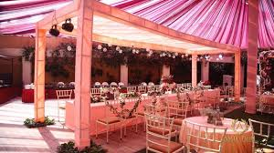
Event Management project
Submitted by:-
Sanchit Khandelwal
Shailina Jain
Shruti Sharma
Tanu Gupta

Slide 2
python
Python is a general-purpose interpreted, interactive, object-oriented, and high-level programming language. It was created by Guido van Rossum during 1985- 1990. Like Perl, Python source code is also available under the GNU General Public License (GPL).
Python is a high-level, interpreted, interactive and object-oriented scripting language. Python is designed to be highly readable. It uses English keywords frequently where as other languages use punctuation, and it has fewer syntactical constructions than other languages.

Slide 3
problem
Today In the existing System, there is lot of patter work which is very much time consuming and uneconomical as most of the works include manual processing. The records are difficult to store in manual system, and it requires more manual labour work.
Moreover the present events are manually managed so there are lots of hustle and bustle managing the payments, different items prices,
food , Decorations therefore it increases management problems.

Slide 4
Literature survey
Lalit sir Notes
Tutorials Point For tkinter references
Stack overflow for doubts
Geeks for Geeks for depth concepts Knowledge

Slide 5
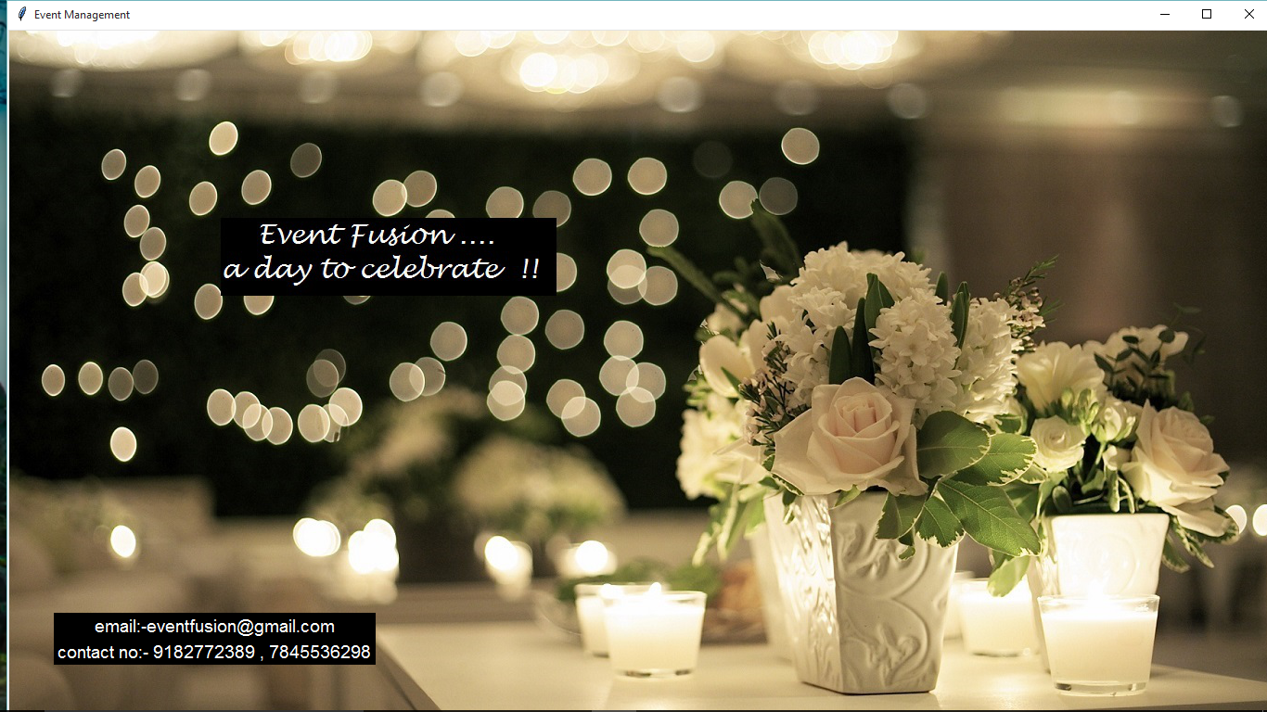
Introduction to project

Slide 6

Intro
In the proposed Event Management System, everything is saved in the form of database. This will immediately reduce the manual processing, thereby increasing the speed of the event management process. There are various functions and modules in the system to perform various features. This overall increases management productivity eliminates paper works, reduce manpower, and prove to be very economical in the long run.

Slide 7
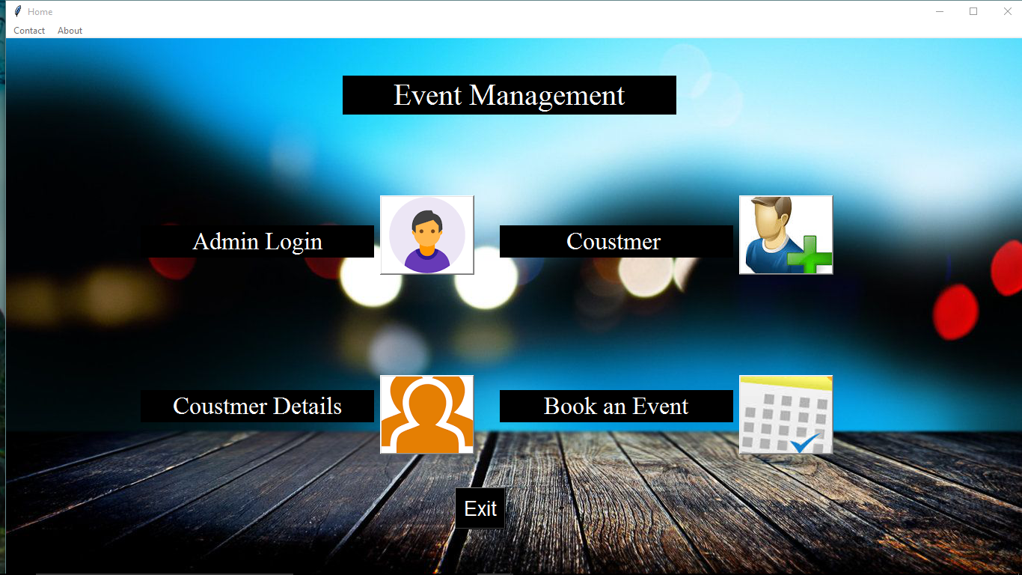
Start

Slide 8
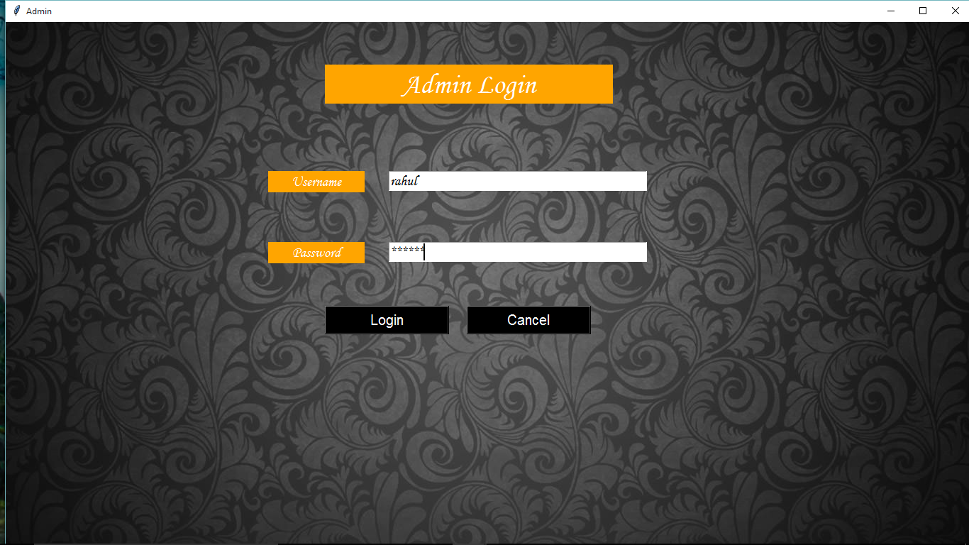
1. Admin Module

Slide 9
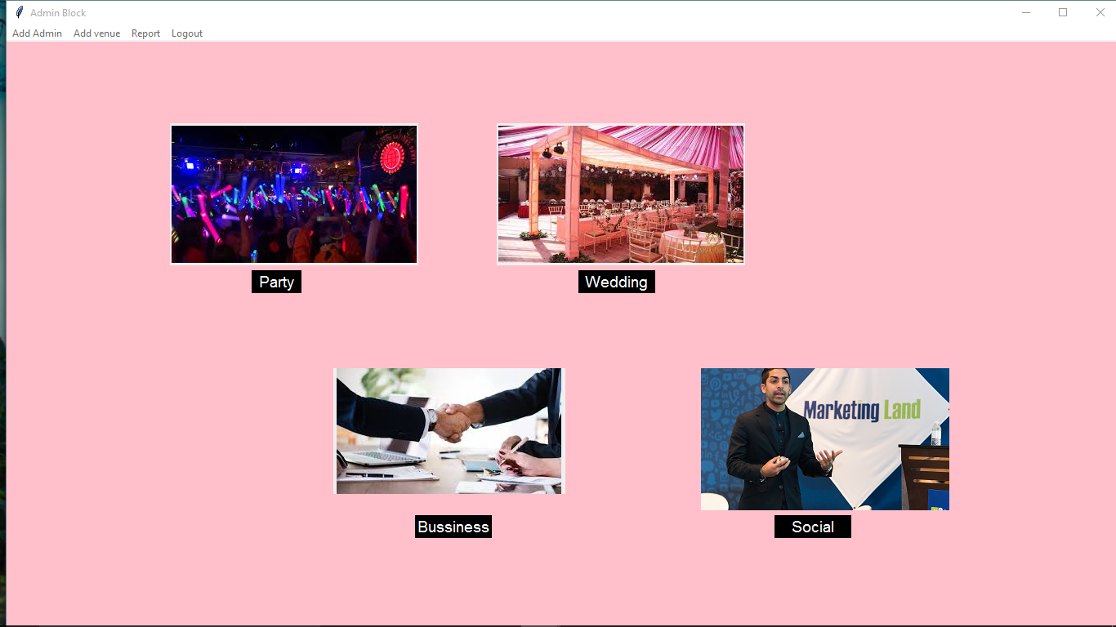
1.1 Admin Module

Slide 10
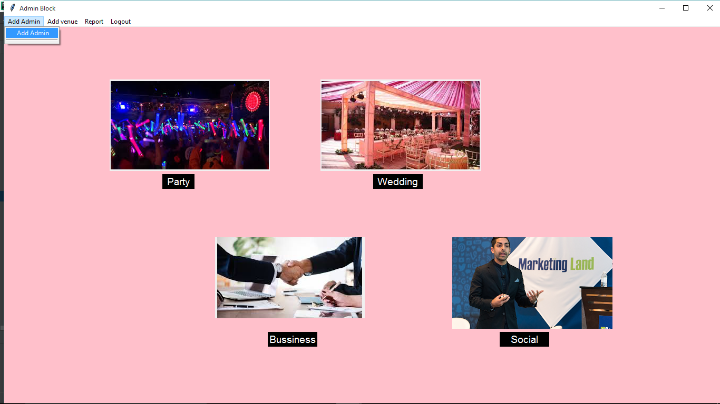
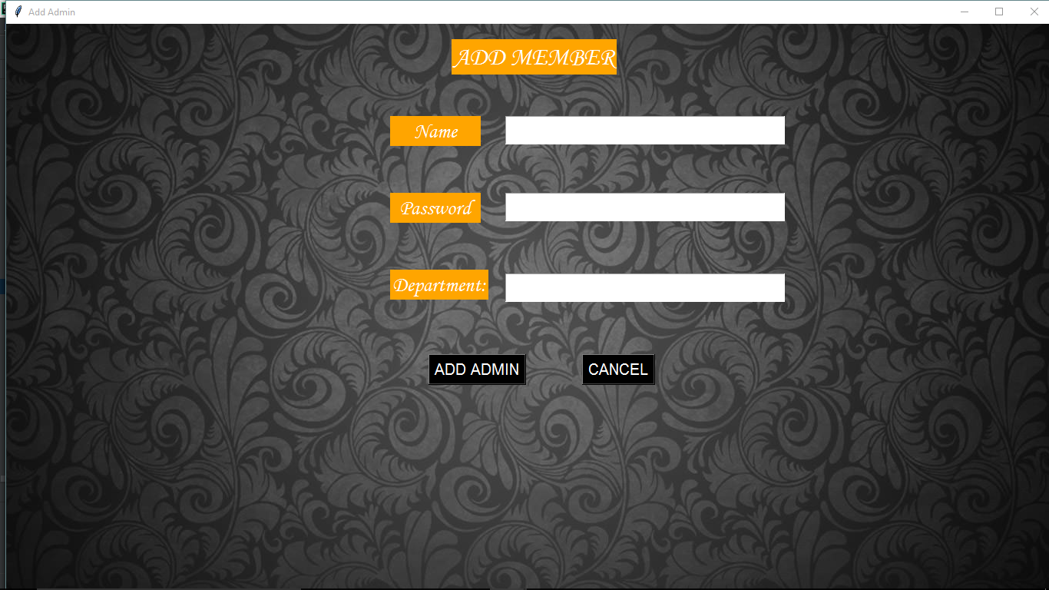
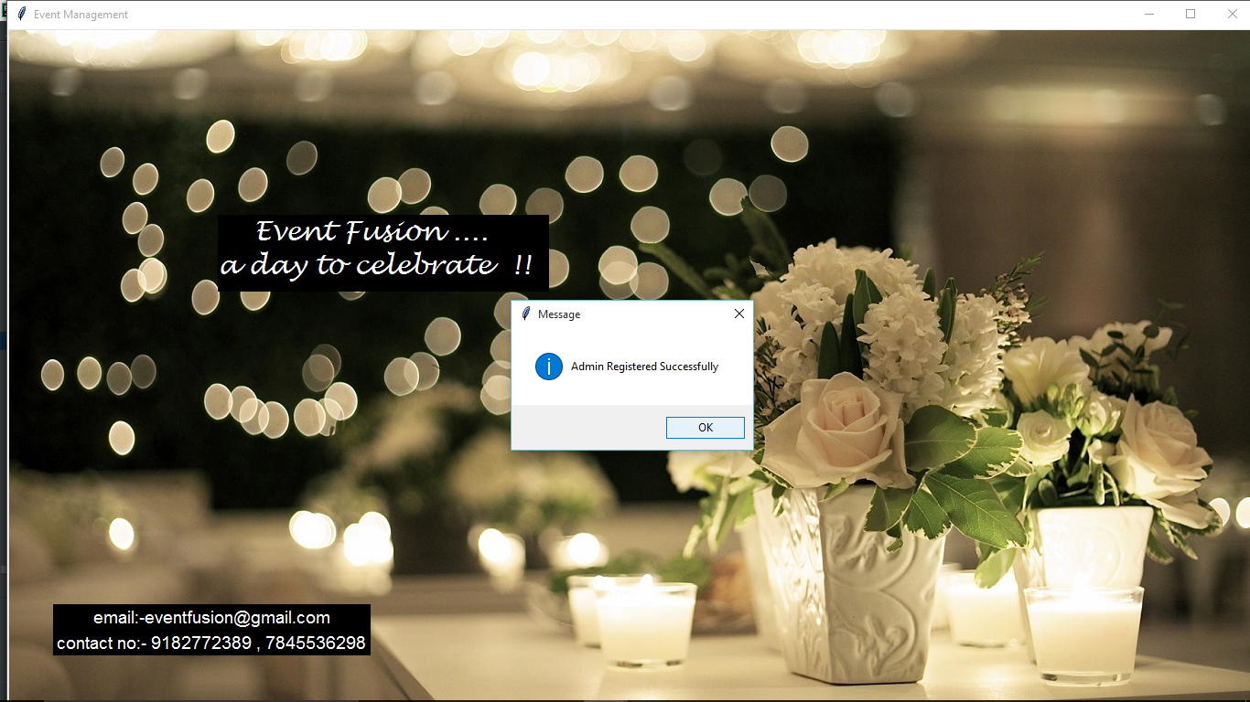
1.2Admin Module

Slide 11
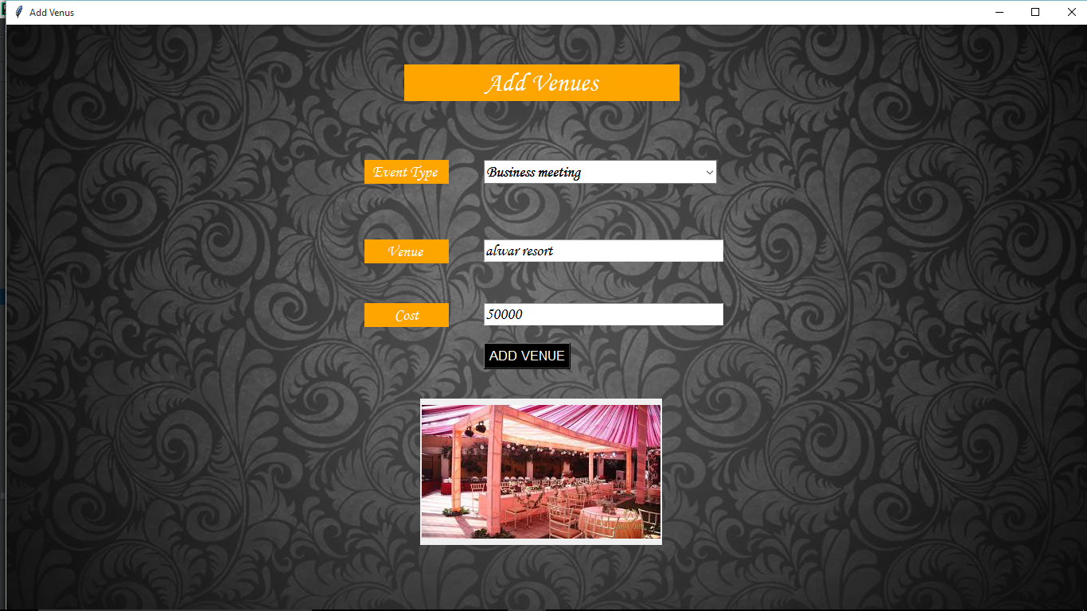

1.3 Add Venue

Slide 12
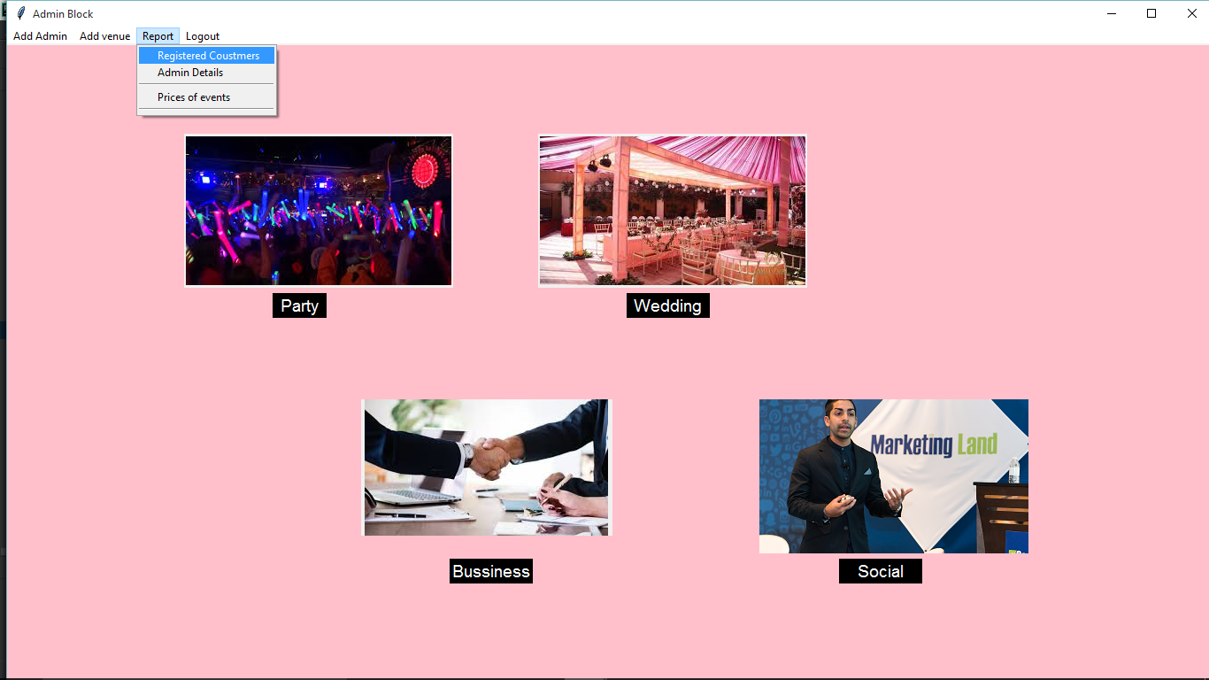
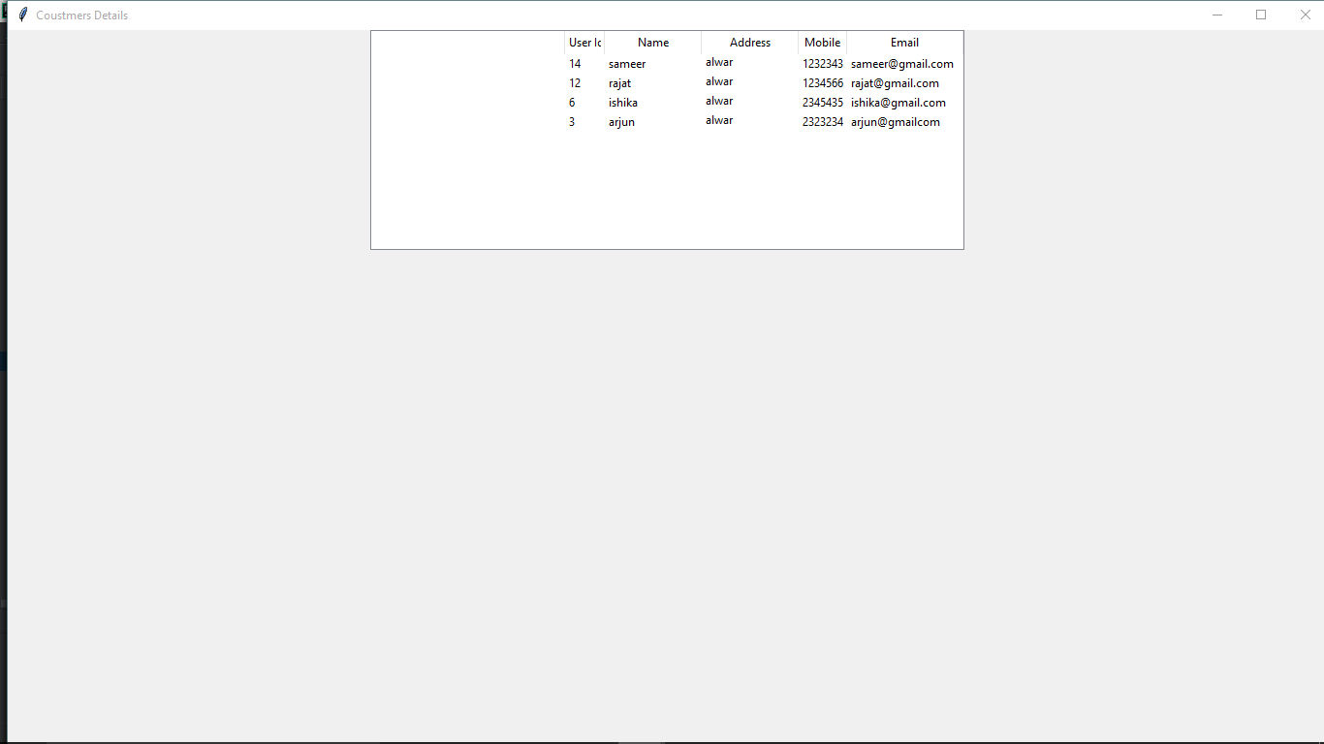
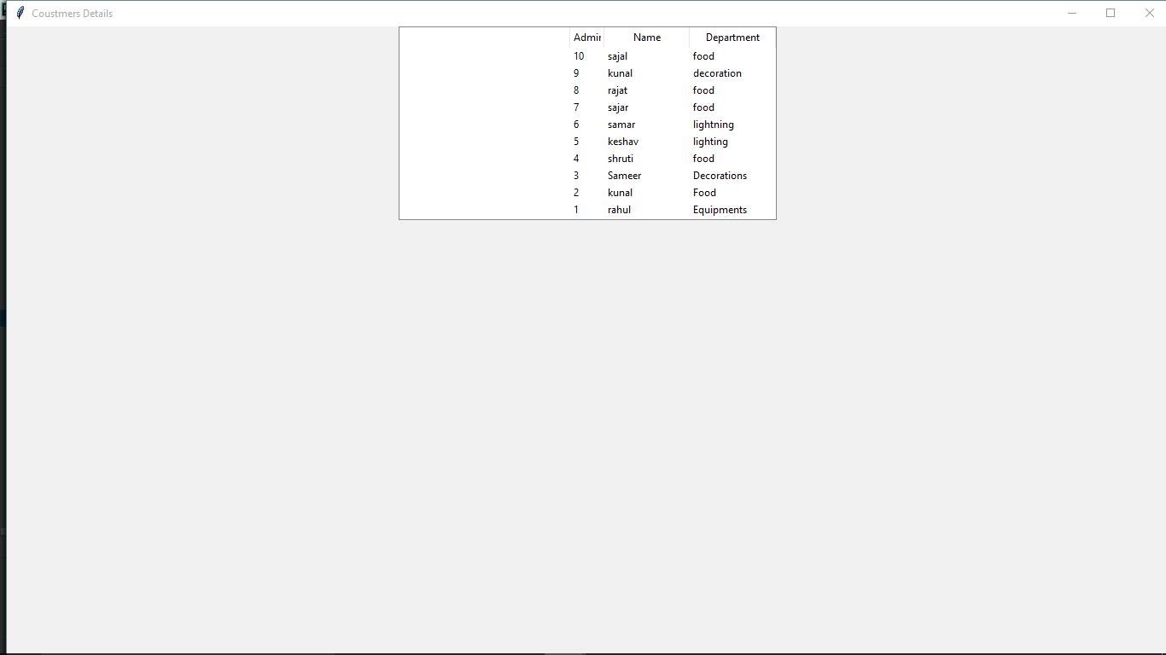
1.4 Report of Registered admin and Costumers

Slide 13
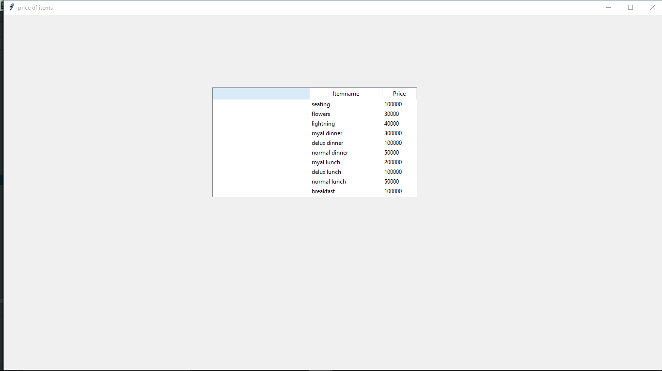
1.5 price of items

Slide 14
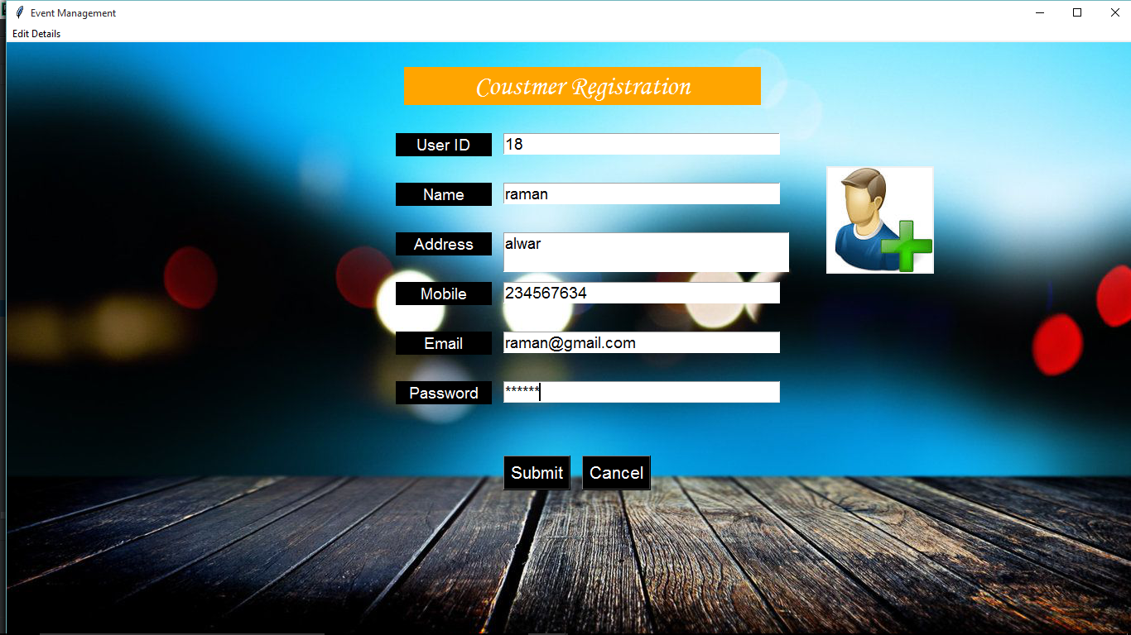

2. Costumer module

Slide 15
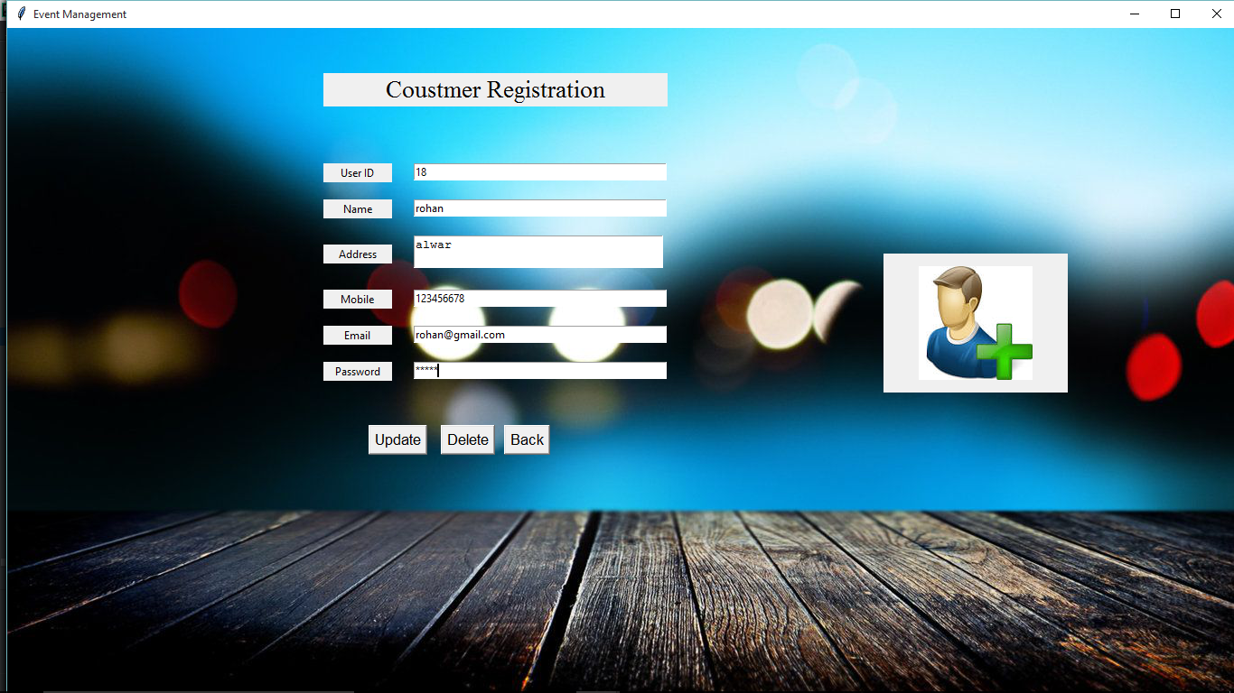

2.1 edit details

Slide 16

2.2 delete Account

Slide 17
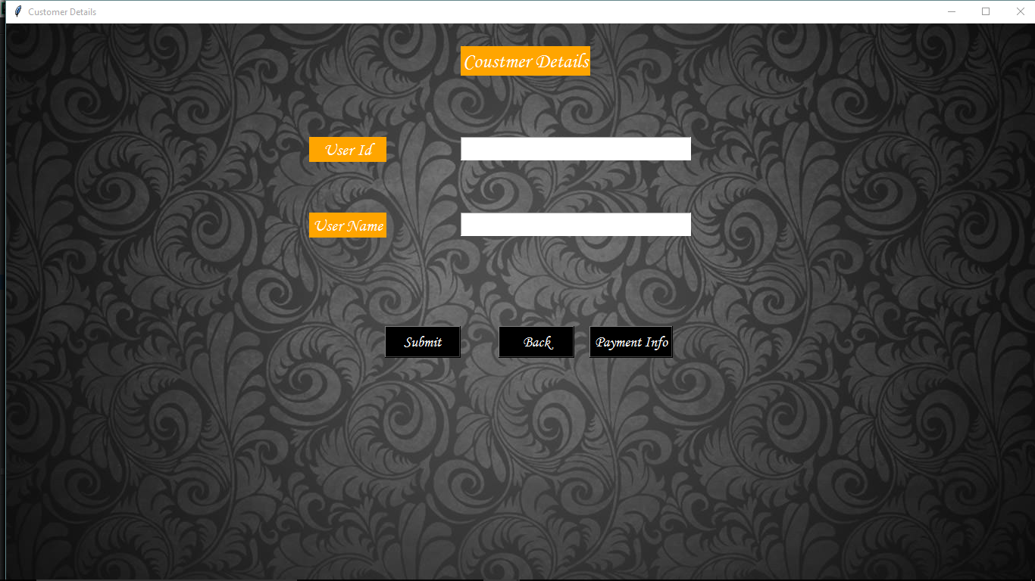
3. Costumer Details Modules

Slide 18
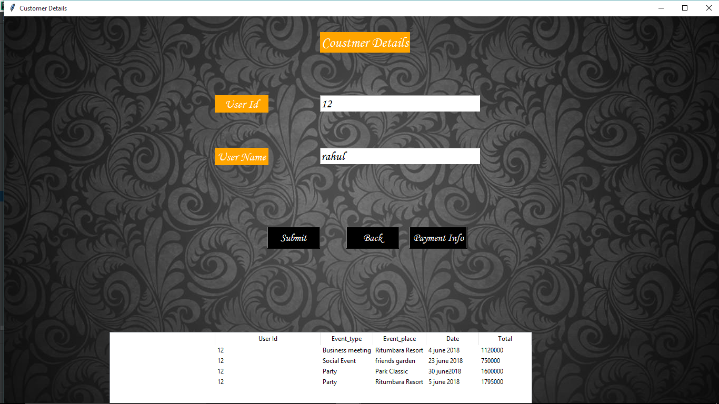
3.1 Different events booked by an user

Slide 19
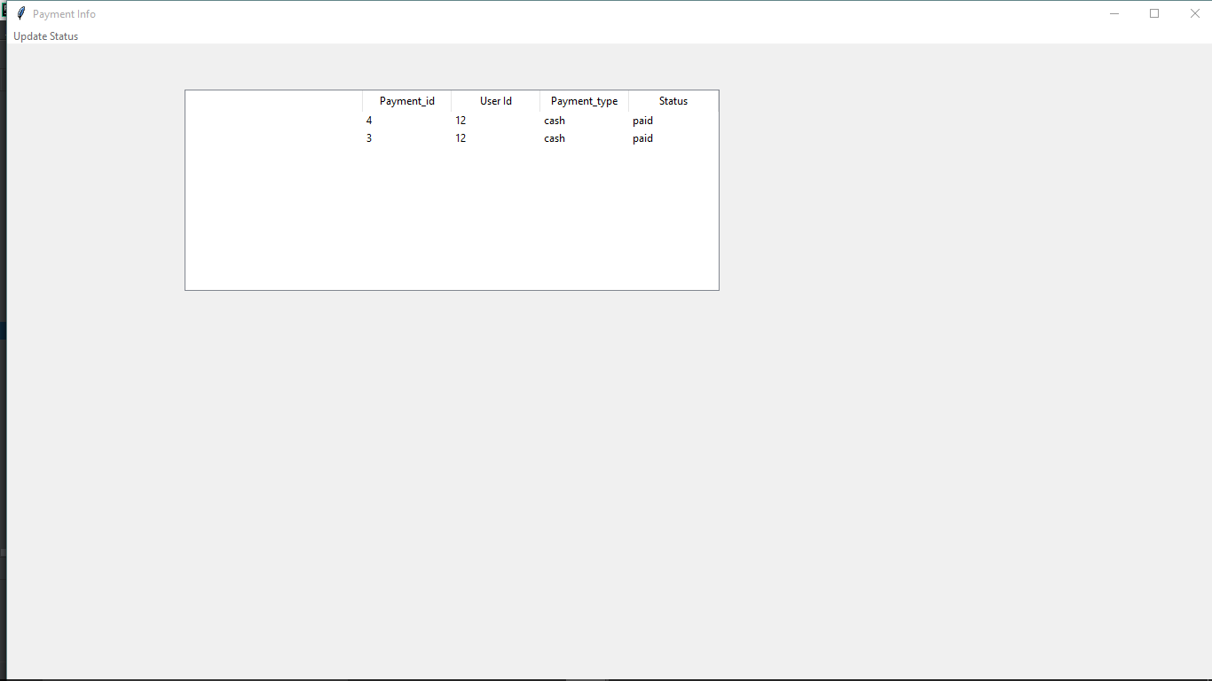
3.2 Update Payment status

Slide 20
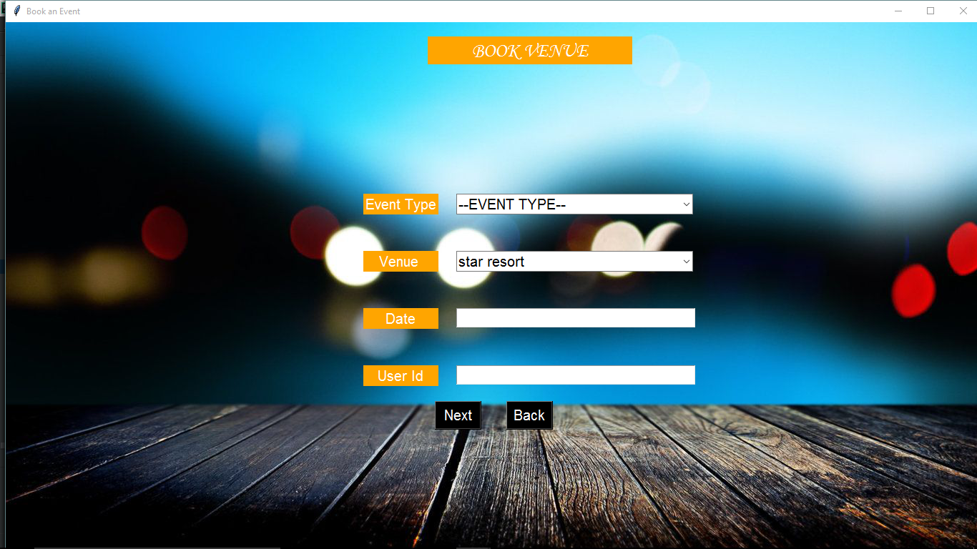
4. Book an event Module

Slide 21
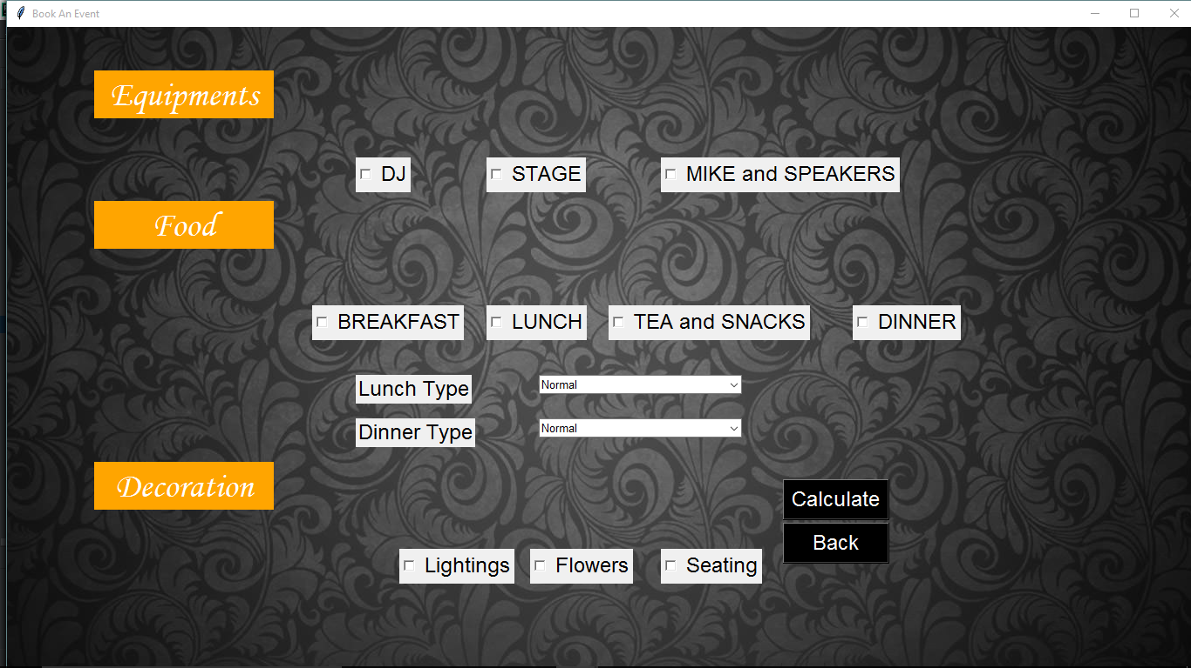
4.1 Booking Items

Slide 22
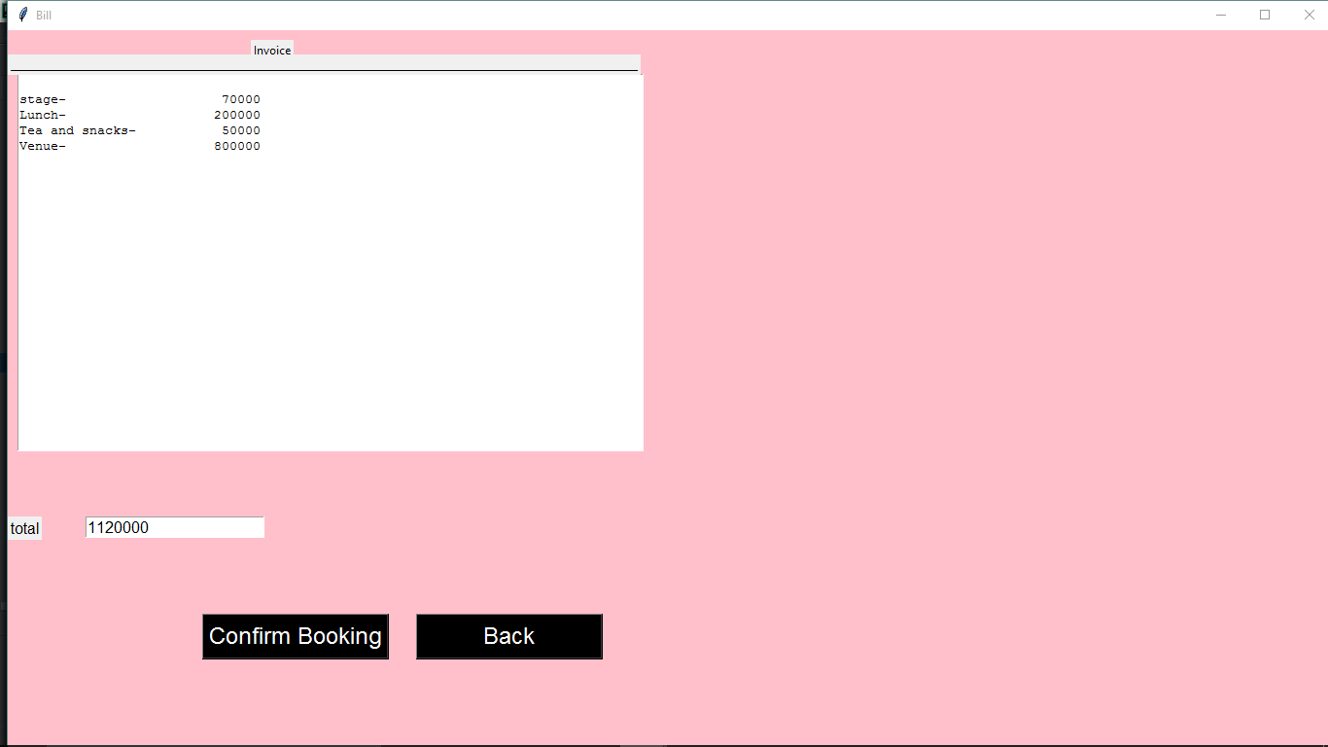
Payment Reciept

Slide 23
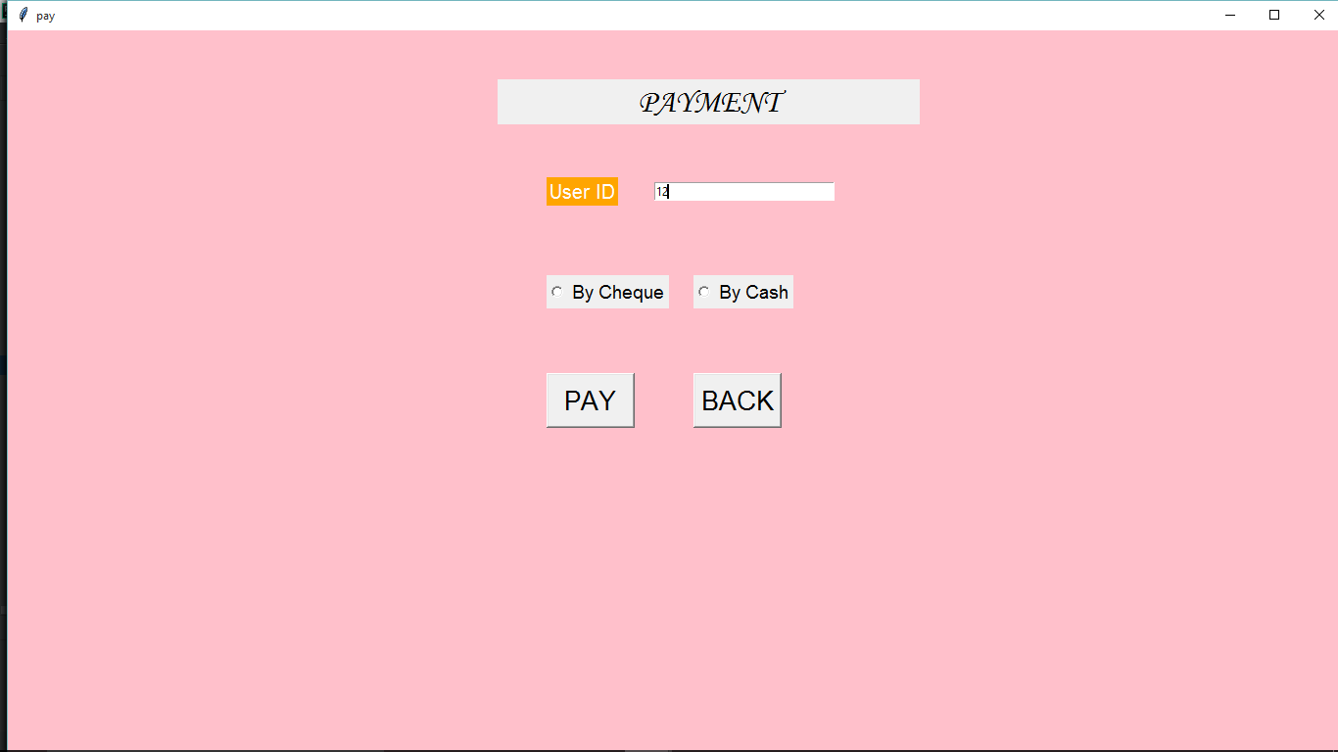
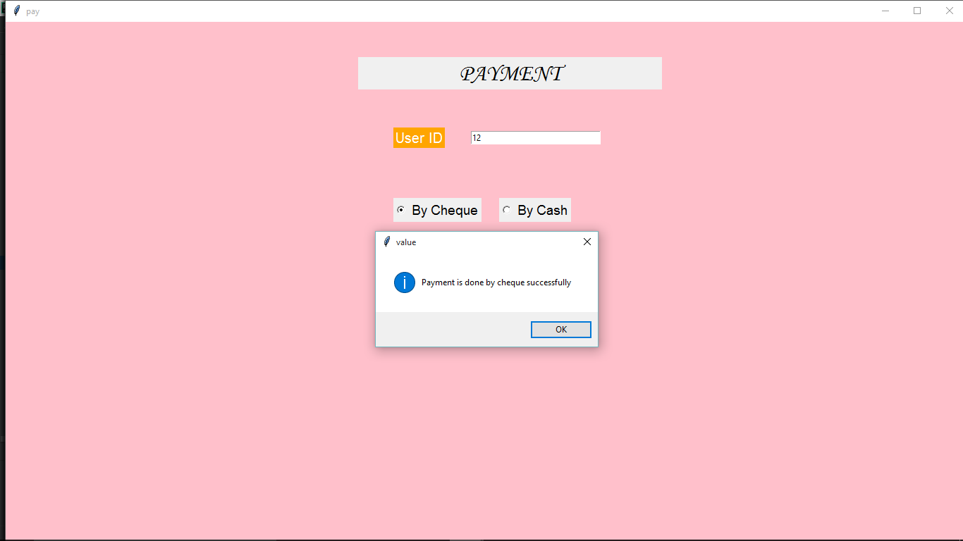
Final Payment

Slide 24
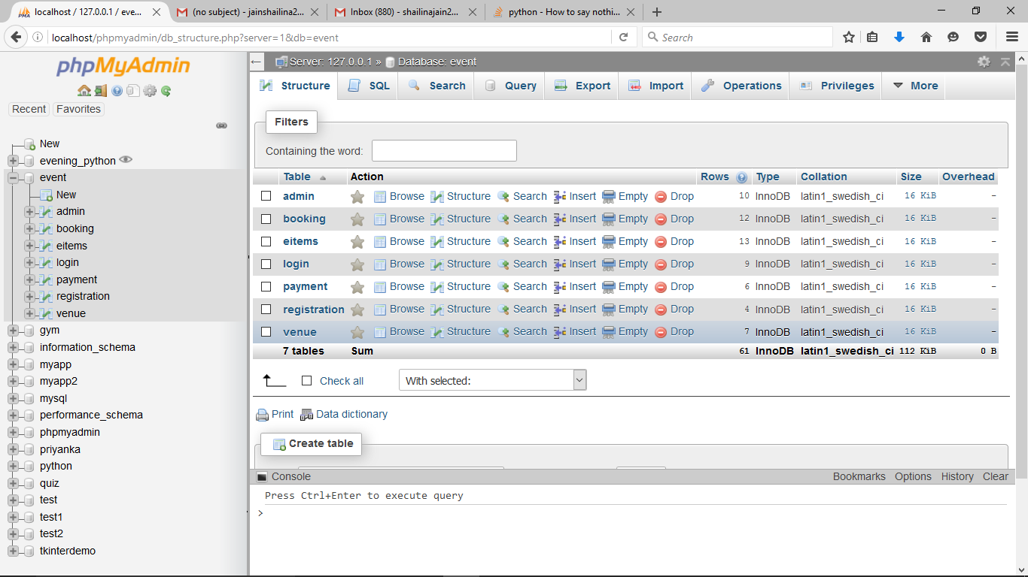
DATABASE TABLES

Slide 25
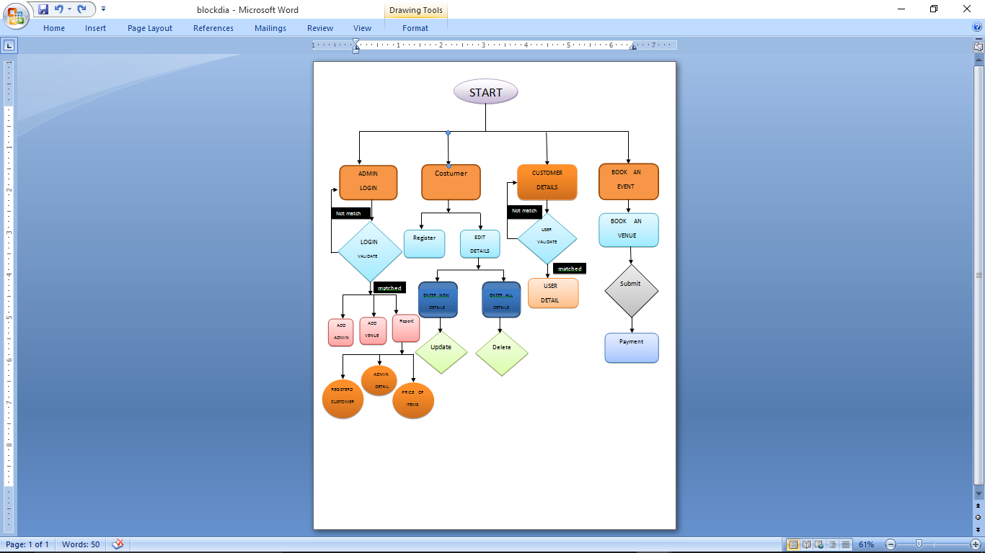
BLOCK DIAGRAM

Slide 26
FUTURE SCOPE
As the demand for events increases so this software will prove to be boon for those industries who with link ups want to make money.
Moreover both the costumer and the user are benefitted by this project as the costumer don’t need to roam in the market to get all the services he can come at a single place and get the vivid varieties of options in venues, food , decoration etc and he can choose according to his budget and similarly the admin also as all the records right from the registration to the payment is maintained in the application.

Slide 27
Thankyou
Thank you Mentors for your support and guidance so as we have successfully made this project.

